Slide 1
College of Humanities and Legal Studies
School of Business
Centre for Entrepreneurship and Small Enterprise Development

Slide 2
Entrepreneurship
Dr Edward Amarteifio
CESED – School of Business
University of Cape Coast
Cape Coast

Slide 3
“Much of our American progress has been the product of the individual who had an idea; pursued it; fashioned it; tenaciously clung to it against all odds; and then produced it, sold it and profited from it.”
--Hubert Humphrey, 1966

Slide 4
WHO IS AN ENTREPRENEUR

Slide 5
Who is this “Man”
He was born on September 9, 1890
In 1895, his father came home with a fever and died later that day
At age 5, he was required to look after and cook for his siblings
By the age of 7, he was skilled with bread and vegetables, and improving his meat cooking
At 10, he began to work as a farmhand for some local farmers

Slide 6
At 12, he dropped out of seventh grade
At 13, he finally left home and took a job painting horse carriages
At 16, he joined the army
By 17, he had already lost 4 jobs
He got married at 18
Got divorced at 20
He later became a cook and a dishwasher in a Shell Service station and in 1930 took over the business
In July 1939, he acquired a motel and the motel was destroyed in a fire by November

Slide 7
He had the motel rebuilt with a 140-seat restaurant
By July 1940, he had finalized his "Secret Recipe" for frying chicken in a pressure fryer
The war forced him to close down his motel
At 65, he finally retired and received a cheque of $105.
He tired committing suicide but wasn’t successful
By the time of his death, there were an estimated 6,000 KFC outlets in 48 countries worldwide

Slide 8
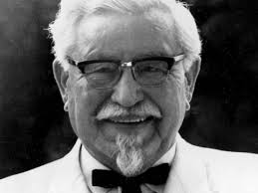
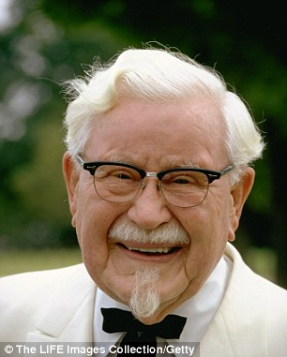


Slide 9
What is Entrepreneurship

Slide 10
Entrepreneurs Challenging the Unknown
Entrepreneurs
Recognize opportunities where others see chaos or confusion
Are aggressive catalysts for change within the marketplace
Challenge the unknown and continuously create the future

Slide 11
Entrepreneurship: A Mindset
Entrepreneurship is more than the mere creation of business:
Seeking opportunities
Taking risks beyond security
Having the tenacity to push an idea through to reality
Entrepreneurship is an integrated concept that permeates an individual’s business in an innovative manner.
Notes:
11

Slide 12
Tracing the Meaning of Entrepreneurship
No single universally accepted definition of entrepreneurship
Economists, psychologists, sociologists, management scientists, have different ideas about what is “entrepreneurship” and the “entrepreneur”

Slide 13
Richard Cantillon, France (1680-1734)
Generally acknowledged as the first to use the word “entrepreneur” in a commercial sense – he coined entrepreneur (undertaker) or from the root word entreprendre).
The entrepreneur “buys at a certain price and sells at an uncertain price.”

Slide 14
Adam smith, British Economist, (1723-1790)
The “enterpriser” is a person with unusual foresight and could recognize the potential for goods and services;
Profits are the reward for risking capital (virtually no separation between Capital and Entrepreneurship as factors of production).

Slide 15
Jean Baptise Say, French (1767 -1832)
Entrepreneurship is virtually the same as management.
The entrepreneur brings together the factors of production and plays a central coordinating role in production and distribution.
The entrepreneur is one with a key role in his own enterprise: the leader and manager.

Slide 16
Joseph Alois Schumpeter, Austrian Economist (1883-1950)
Joseph Alois Schumpeter, Austrian economist, later professor of economics, at Harvard (1883 – 1950)
The entrepreneur occupies a central position in economic development – through innovation- breaking the status quo.
Entrepreneurship is a process of “creative destruction” – destroying the old and creating the new.

Slide 17
Hisrich and Peters (1998, p. 9)
define entrepreneurship as the ‘process of creating something new with value by devoting the necessary time and effort, assuming the accompanying financial, psychic and social risks and receiving the resulting rewards of monetary, personal satisfaction and independence’.

Slide 18
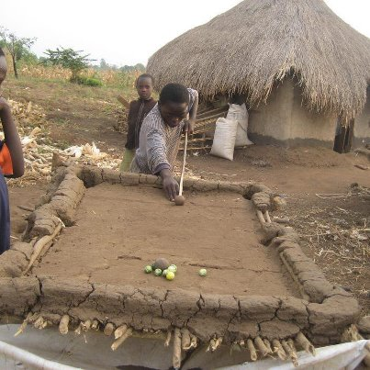

Slide 19
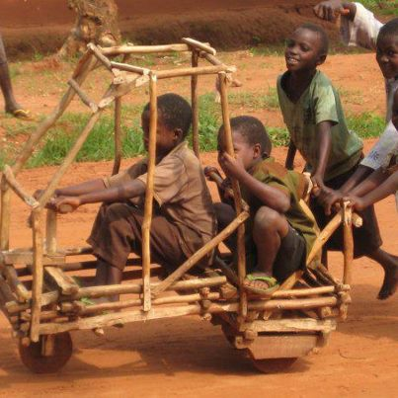

Slide 20
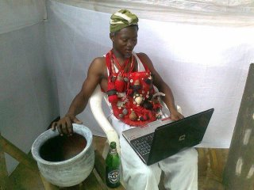

Slide 21



Aspects of Entrepreneurship
Venture Financing
Corporate Entrepreneurship
Social Entrepreneurship
Trends in Entrepreneurship Research
Entrepreneurial Cognition
Women and Minority Entrepreneurs
Global Entrepreneurial Movement
Entrepreneurial Education
Family Businesses
Notes:
21

Slide 22

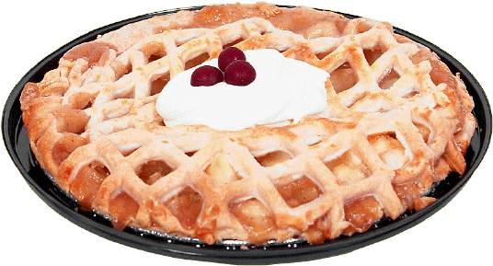
Reasons Why People become Entrepreneurs

Slide 23
Personal satisfaction
Entrepreneurial skills
Success stories
Desire for independence
Opportunity to exploit a gap
Frustration
Prestige

Slide 24
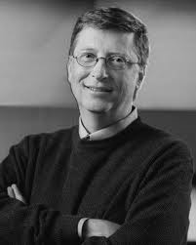
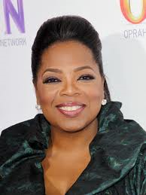
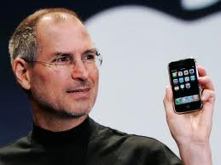
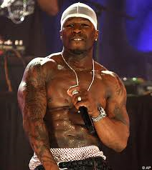
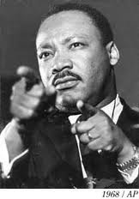
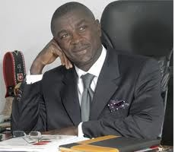
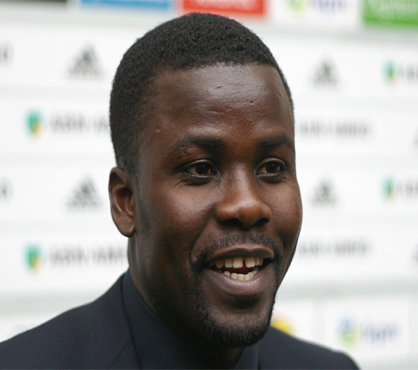
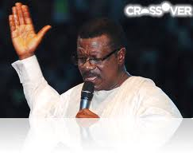
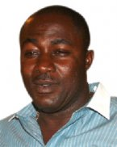
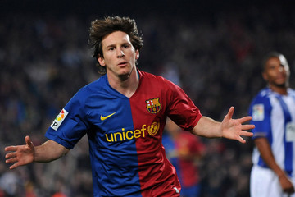
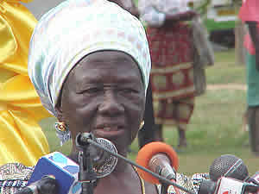
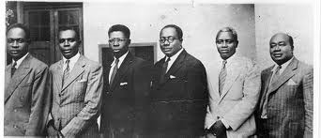

Slide 25
"I used to serve tea at a shop to support my football training" - Lionel Messi
"I used to sleep on the floor in friends' rooms, returning Coke bottles for food money, and getting weekly free meals at a local temple" - Steve Jobs
"My teachers used to call me a failure" - Tony Blair
"I didn't even complete my University Education" - Bill Gates
"In my childhood days, I stitched shoes" - Abraham Lincoln
"I struggled academically throughout elementary school" - Ben Carson

Slide 26
"I played many Shows for Many Show Organizers and they always Paid me with T-Shirts and Toffees, I nearly stopped Raping" ‪#‎Sarkodie"
My Mum was a Pito Seller But That Didn't stop me From Achieving my Dreams" - ‪#‎Samini"
I had a car accident, I lost my twin Brother and I nearly Lost one of my Legs But still I Chase my Dreams" -‪#‎StonebwoyBurniton"
My Parents Abandoned and Rejected Me, bcuz I chose to be a singer" - ‪#‎ShattaWale"
My First time in "Key Soap Concert Party Audition" They Rejected Me" ‪#‎AgyaKoo"

Slide 27
I Even went to work with someone as a car repairer (rip33la) but he later sacked me, because I fool too much" - ‪#‎KwakuManu
"I went To TV3 Mentor Audition, but they rejected me" - ‪#‎Becca"
I was once an armed robber" - ‪#‎Archbishop Duncan Williams"
I was only a shoe maker, sometimes, i think all this things happening to me is a dream" - CEO Of PeaceFM & UTV ‪#‎KwameDespite"
I was not interested in school bcuz my mates and teachers always called me 'GYIMI'"- ‪#‎KojoNkansahLilWin."

Slide 28
My first coach once told me, you can't be a player, is better to be a ball boy for my team or just try to be a musician' i felt very bad that very moment" -‪#‎AsamoahGyan
"In London I was a Taxi Driver, in America I was a plate washer, I nearly Kill my dream to be a street sweeper" - ‪#‎KennedyAgyapong
"I told my school mates I'll be a president, they started using that to tease me, 'Mr.President! Mr. President'" - Ex. Prez.‪#‎JAKuffour

Slide 29

Benefits of Entrepreneurship
The opportunity to:
Create your own destiny
Make a difference
Reach your full potential
Reap impressive profits
Contribute to society and to be recognized for your efforts
Do what you enjoy and to have fun at it

Slide 30

Drawbacks of Entrepreneurship
Uncertainty of income
Risk of losing your entire investment
Long hours and hard work
Lower quality of life until the business gets established
High levels of stress
Complete responsibility
Discouragement

Slide 31
Avoiding the Pitfalls of Small Business Failure
Know your business in depth
Develop a solid business plan
Manage financial resources
Understand financial statements
Learn to manage people effectively
Set your business apart from the competition
Maintain a positive attitude

Slide 32
Feeding the Entrepreneurial Fire
Entrepreneurs as heroes
Entrepreneurial education
Demographic and economic factors
Shift to a service economy
Technology advancements
Independent lifestyle
E-commerce and the Internet

Slide 33
Some successful entrepreneurs (Role models)

Slide 34
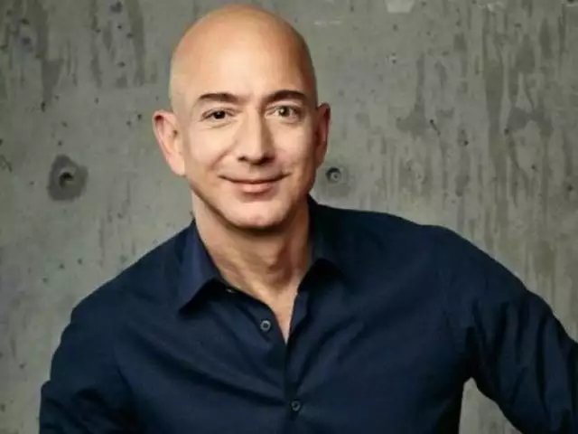
Jeff Bezos $150 billion
Entrepreneur and e-commerce pioneer Jeff Bezos was born on January 12, 1964, in Albuquerque, New Mexico. Bezos had an early love of computers and studied computer science and electrical engineering at Princeton University. After graduation he worked on Wall Street, and in 1990 he became the youngest senior vice president at the investment firm D.E. Shaw. Four years later, he quit his lucrative job to open Amazon.com, a virtual bookstore that became one of the internet's biggest success stories. In 2013, Bezos purchased TheWashington Post in a $250 million deal. His successful business ventures have made him one of the richest people in the world.

Slide 35
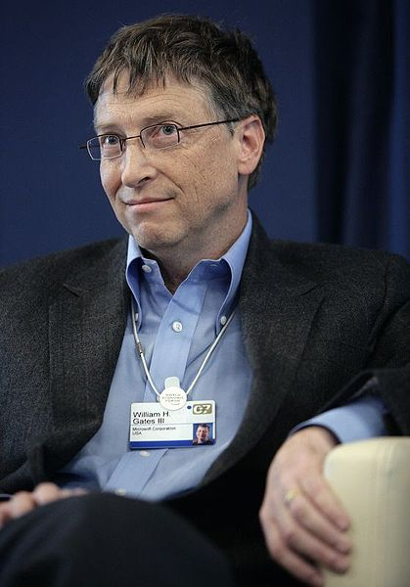
William Henry Bill Gates III
“It's fine to celebrate success but it is more important to heed the lessons of failure,”
Bill Gates discovered his interest in software and began programming computers at age 13. He is the chief software architect of Microsoft Corporation, the worldwide leader in software, services and solutions that help people and businesses realize their full potential
Net worth $95.8 billion

Slide 36
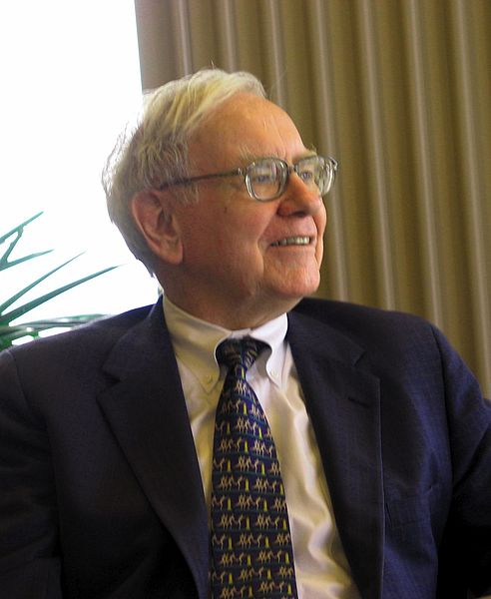
Warren Buffett
I’m 15 percent Fisher and 85 percent Benjamin Graham. The basic ideas of investing are to look at stocks as business, use the market's fluctuations to your advantage, and seek a margin of safety. That’s what Ben Graham taught us. A hundred years from now they will still be the cornerstones of investing.
is an American investor, businessman, and philanthropist. He is one of the most successful investors in the world, the primary shareholder and CEO of Berkshire Hathaway
$88.7 billion

Slide 37
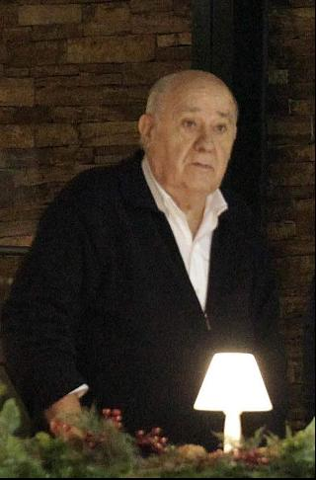
Spaniard Amancio Ortega grew up the son of a railway worker and is now the world's richest retailer. He cofounded Zara in 1975 with lingerie and bathrobes he and his former wife Rosalia Mera made in their living room. By the mid-1980s, he had taken Zara all over Spain and was ready to expand overseas.
$65.1 Billion

Slide 38
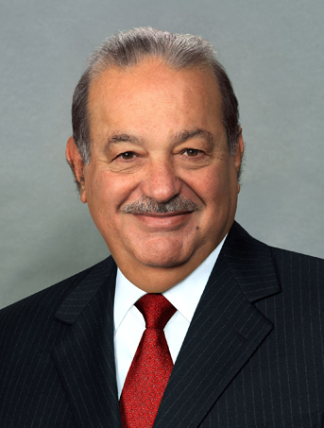
Carlos Slim Helu 76– Telecom $63.3 billion
First showed a talent for business as a 10-yr old kid when he filled his pockets with pesos selling drinks and snacks to his family members and friends

Slide 39
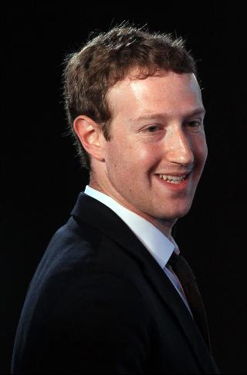
Zuckerberg founded the Facebook in 2004 and dropped out of Harvard to move the company to Silicon Valley. Facebook now has nearly 11,000 employees in 48 offices around the globe. Since launching its Internet.org initiative in July 2014, Facebook has given free basic Internet services to more than a billion people in 17 countries in Asia, Africa and Latin America.
$62.1 Billion
6th Richest

Slide 40
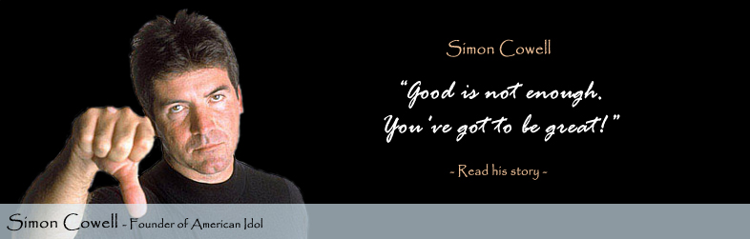
Simon Cowell
In 1979, he got his first job working as a mail room clerk for EMI Music Publishing. “In many ways, I was glad that I had started my career on the very low rung of the business,” Cowell recalls. “It was there that I learned how to deal with people.” Over the next few years, Cowell would work his way up within the ranks of the company to eventually become a record producer. Unsatisfied with his prospects, Cowell left EMI in the early 1980s to form E&S Music, his own independent music company.

Slide 41
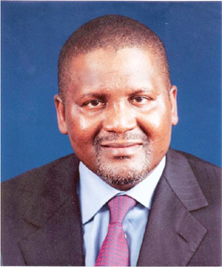
Aliko Dangote 100th Richest
Alikote Dangote - the Nigerian founder and president of Dangote Group. He is known to be one the richest man in Africa , but he said "I think I have to be rated by Forbes magazine first before I can be called the richest man in Africa," says Mr Dangote modestly.The Dangote Group provides cements ,sugar, salt, flour , rice, spaghettis, textile etc at competitive prices.
$12 billion

Slide 42
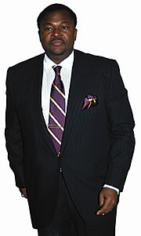
Dr. Mike Adenuga Jnr.
The man Adenuga means different things to different people. A husband, father, team leader, role model, benefactor and an entrepreneur par excellence while some would argue that he is one of the champions of Nigeria’s economic development!
A man of abundant positive energy and immense personal drive, Adenuga still drives himself around town in his choice automobiles even though there are drivers at his beck and call. Adenuga has thus also become a metaphor in modesty

Slide 43
Other entrepreneurs
Asuma Banda
Kwabena Darko
Prince Kofi Amoabeng
Ken Ofori-Atta
Daniel J. Otoo

Slide 44
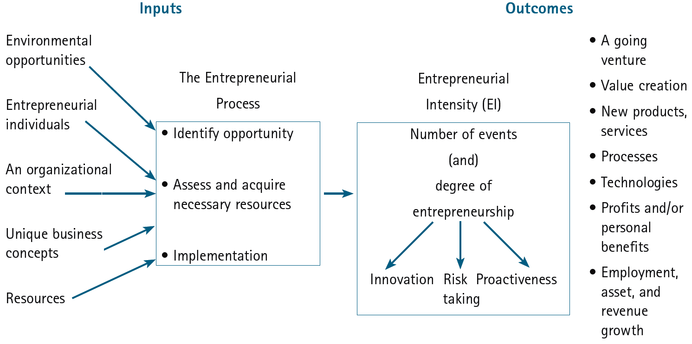
An Integrative Model of Entrepreneurial Inputs and Outcomes
Source: Michael H. Morris, P. Lewis, and Donald L. Sexton, “Reconceptualizing Entrepreneurship: An Input-Output Perspective,” SAM Advanced Management Journal 59, no.1 (Winter 1994): 21–31.
Notes:
44

Slide 45
Life is not about what you couldn't do so far, it's about WHAT YOU STILL CAN! So never give up!....

